Slide 1
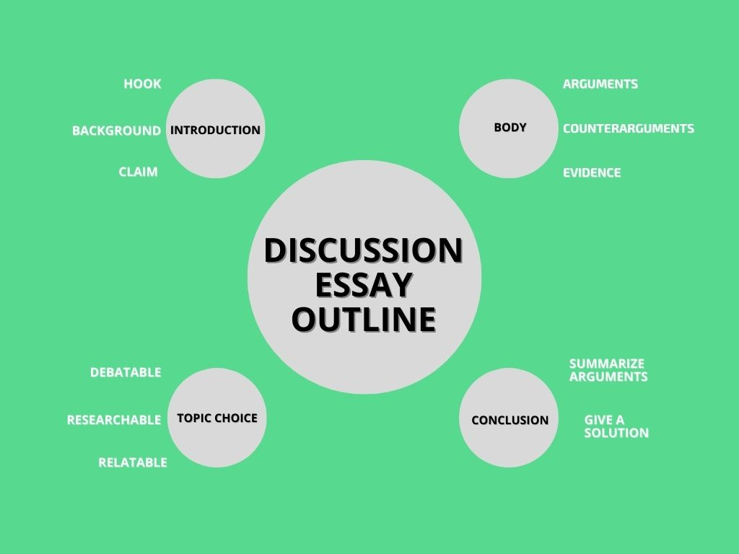

Slide 2
Discussion Essays
The Question
The first part of the question for an IELTS discussion essay will be a statement containing two opposing views.
You will then be asked to discuss both sides of the argument and give your own opinion. Here is some typical wording that might be used:
Discuss both views and give your opinion.
Discuss both these views and then give your own opinion.
Discuss both sides of this argument and give your own opinion.

Slide 3
Discussion Essays
Some people think that zoos are cruel and should be closed down. Others, however, believe that zoos can be useful in protecting wild animals.
Discuss both views and give your opinion.
Give reasons for your answer and include any relevant examples from your own knowledge or experience.
Write at least 250 words.

Slide 4
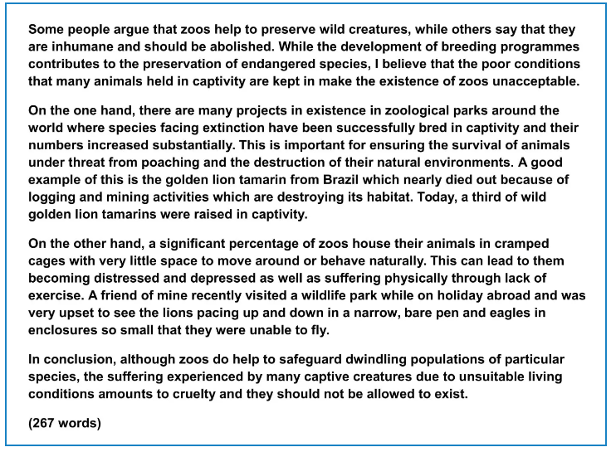
Answer

Slide 5
BREAKDOWN AND EXPLANATION

Slide 6
Discussion Essays
3 Common Mistakes
These three errors are common in IELTS discussion essays.
Not stating your opinion.
Not giving arguments for both views.
Not developing both sides of the argument equally.

Slide 7
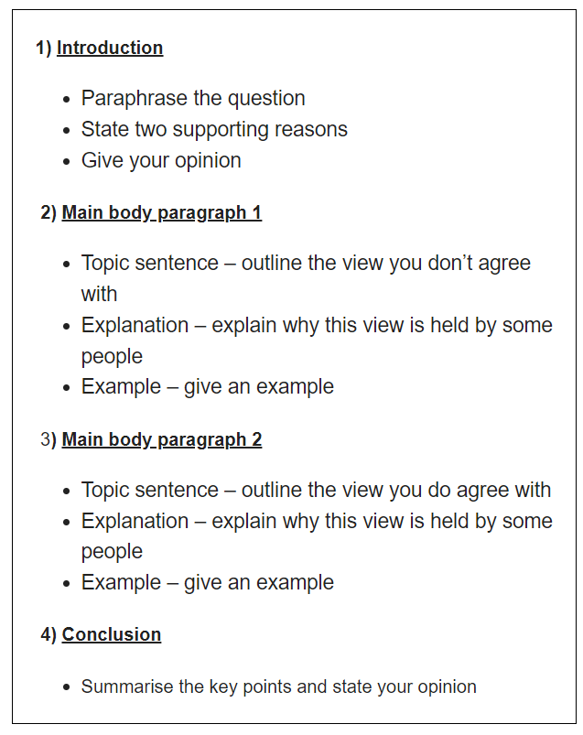
Discussion Essays
Essay Structure

Slide 8
Introduction
A good introduction has a simple 3 part structure:
1) Paraphrased question
2) Thesis statement
3) Outline statement
An introduction should:
Have 2-3 sentences
Be 40-60 words long
Take 5 minutes to write

Slide 9
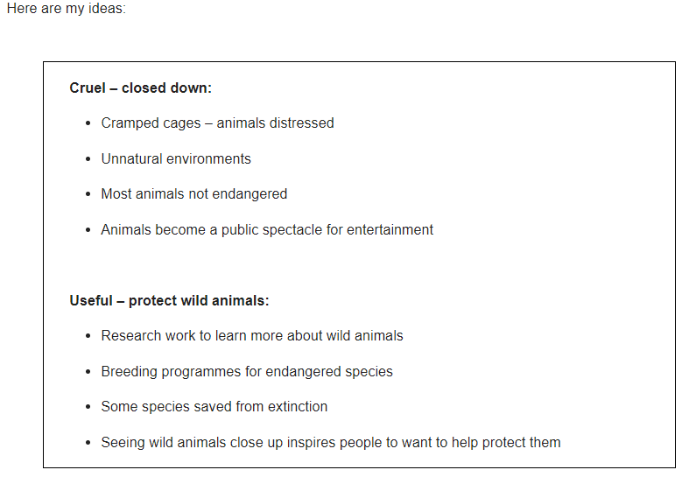

Slide 10
Introduction
Question: Some people think that zoos are cruel and should be closed down. Others, however, believe that zoos can be useful in protecting wild animals. Discuss both views and give your opinion.
Paraphrased question:
Some people argue that zoos help to preserve wild creatures, while others say that they are inhumane and should be abolished.
Thesis statement and Outline statement:
While the development of breeding programmes contributes to the preservation of endangered species, I believe that the poor conditions that many animals held in captivity are kept in make the existence of zoos unacceptable.
*abolish-get rid of
DO NOT GIVE ANY HEADING
THE HEADINGS OF THE PARAGRAPHS ARE FOR EXPLANATION ONLY
YOUR WRITING SHOULD ONLY HAVE PARAGRAPHS AS SHOWN IN THE LAST SLIDE

Slide 11
Question: Some people think that zoos are cruel and should be closed down. Others, however, believe that zoos can be useful in protecting wild animals. Discuss both views and give your opinion.
Introduction:
Some people argue that zoos help to preserve wild creatures, while others say that they are inhumane and should be abolished. While the development of breeding programmes contributes to the preservation of endangered species, I believe that the poor conditions that many animals held in captivity are kept in make the existence of zoos unacceptable.
DO NOT GIVE ANY HEADING
THE HEADINGS OF THE PARAGRAPHS ARE FOR EXPLANATION ONLY
YOUR WRITING SHOULD ONLY HAVE PARAGRAPHS AS SHOWN IN THE LAST SLIDE

Slide 12
How To Write Main Body Paragraphs
Topic sentence
Explanation
Example

Slide 13
Main Body Paragraph 1: Idea 1 – Breeding programmes for endangered species, some species saved from extinction.
Topic sentence:
On the one hand, there are many projects in existence in zoological parks around the world where species facing extinction have been successfully bred in captivity and their numbers increased substantially.
Explanation sentence:
This is important for ensuring the survival of animals under threat from poaching and the destruction of their natural environments.
Example sentence:
A good example of this is the golden lion tamarin from Brazil which nearly died out because of logging and mining activities which are destroying its habitat. Today, a third of wild golden lion tamarins were raised in captivity.
*substantially-largely *poach-hunt illegally *logging-cutting trees for selling
DO NOT GIVE ANY HEADING
THE HEADINGS OF THE PARAGRAPHS ARE FOR EXPLANATION ONLY
YOUR WRITING SHOULD ONLY HAVE PARAGRAPHS AS SHOWN IN THE LAST SLIDE

Slide 14
Finished Paragraph 1
On the one hand, there are many projects in existence in zoological parks around the world where species facing extinction have been successfully bred in captivity and their numbers increased substantially. This is important for ensuring the survival of animals under threat from poaching and the destruction of their natural environments. A good example of this is the golden lion tamarin from Brazil which nearly died out because of logging and mining activities which are destroying its habitat. Today, a third of wild golden lion tamarins were raised in captivity.
DO NOT GIVE ANY HEADING
THE HEADINGS OF THE PARAGRAPHS ARE FOR EXPLANATION ONLY
YOUR WRITING SHOULD ONLY HAVE PARAGRAPHS AS SHOWN IN THE LAST SLIDE

Slide 15
Main Body Paragraph 2: Idea 2 – Cramped cages & unnatural environments, animals distressed.
Topic sentence:
On the other hand, a significant percentage of zoos house their animals in cramped cages with very little space to move around or behave naturally.
Explanation sentence:
This can lead to them becoming distressed and depressed as well as suffering physically through lack of exercise.
Example sentence:
A friend of mine recently visited a wildlife park while on holiday abroad and was very upset to see the lions pacing up and down in a narrow cage and eagles in enclosures so small that they were unable to fly.
DO NOT GIVE ANY HEADING
THE HEADINGS OF THE PARAGRAPHS ARE FOR EXPLANATION ONLY
YOUR WRITING SHOULD ONLY HAVE PARAGRAPHS AS SHOWN IN THE LAST SLIDE

Slide 16
Finished Paragraph 2
On the other hand, a significant percentage of zoos house their animals in cramped cages with very little space to move around or behave naturally. This can lead to them becoming distressed and depressed as well as suffering physically through lack of exercise. A friend of mine recently visited a wildlife park while on holiday abroad and was very upset to see the lions pacing up and down in a narrow cage and eagles in enclosures so small that they were unable to fly.
DO NOT GIVE ANY HEADING
THE HEADINGS OF THE PARAGRAPHS ARE FOR EXPLANATION ONLY
YOUR WRITING SHOULD ONLY HAVE PARAGRAPHS AS SHOWN IN THE LAST SLIDE

Slide 17
Conclusion
You can start almost any final paragraph of an IELTS essay with the words:
In conclusion
or
To conclude
To create a great conclusion, you simply have to paraphrase the introduction

Slide 18
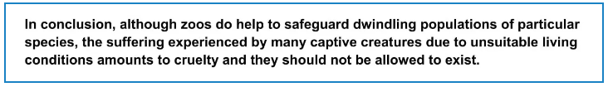
Question: Some people think that zoos are cruel and should be closed down. Others, however, believe that zoos can be useful in protecting wild animals. Discuss both views and give your opinion.
Introduction:
Some people argue that zoos help to preserve wild creatures, while others say that they are inhumane and should be abolished. While the development of breeding programmes contributes to the preservation of endangered species, I believe that the poor conditions that many animals held in captivity are kept in make the existence of zoos unacceptable.
Conclusion
*dwindle-gradually decrease
DO NOT GIVE ANY HEADING
THE HEADINGS OF THE PARAGRAPHS ARE FOR EXPLANATION ONLY
YOUR WRITING SHOULD ONLY HAVE PARAGRAPHS AS SHOWN IN THE LAST SLIDE

Slide 19
Answer

